Slide 1
Traffic Light Simulation with HC-SR04 Ultrasonic Sensor
JONATHAN GRENALD
6218000259
KURTIZ MEAH
6217000144

Slide 2
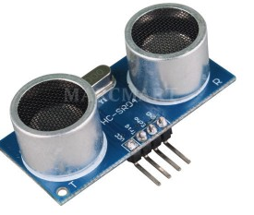
HC- SR04
VCC – 5V (ranging from 4.5 V to 5.5 V)
Trig – Sensor input (trigger)
Echo – Output Sensor (Echo)
GND – Ground

Slide 3
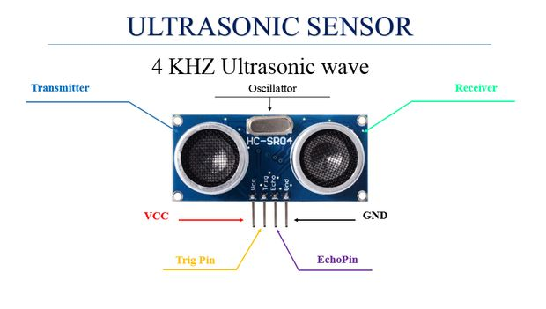

Slide 4
Introduction
The main focus of this project was to simulate a set or traffic lights using arduino. It’s a set of conditions to make the traffic go more smoothly than actually is.
The main functions are served:
a. Using Visual Studio we simulate traffic lights (red, amber, green)
b. Using LEDs to give real world feedback as traffic lights. This should be in sync with the virtual lights shown in VS.

Slide 5
Components Required
Two HC- SR04
Six resistors of 470 ohms
Jumper wires;
Six LEDs of different colors;
2 Breadboard
Toy Cars
Cardboard (Drawing of roads)

Slide 6
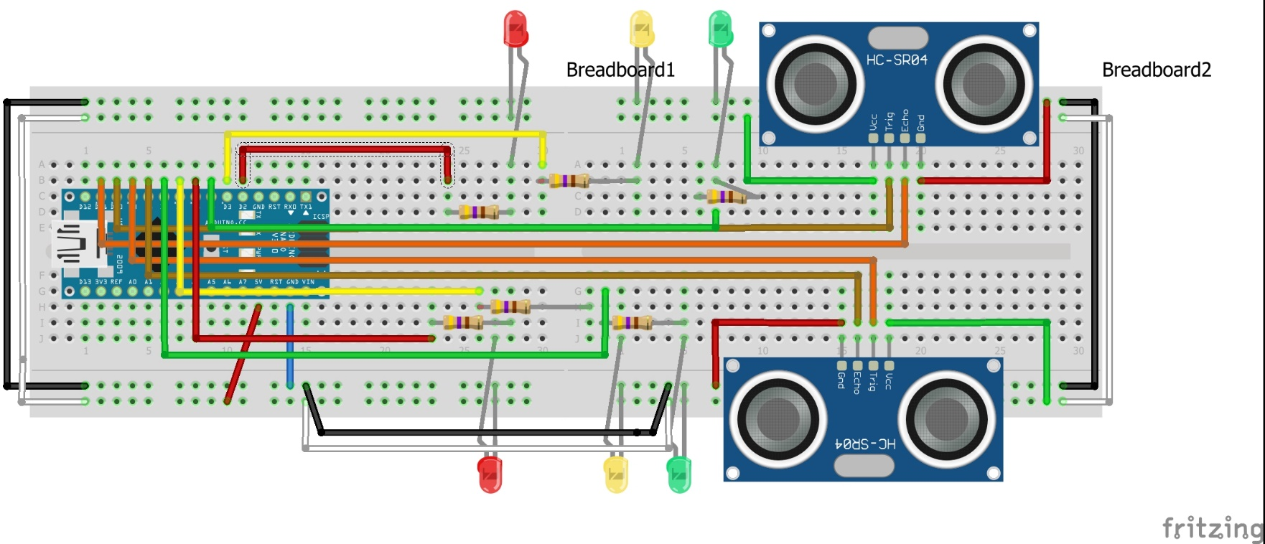
Circuit Diagram

Slide 7
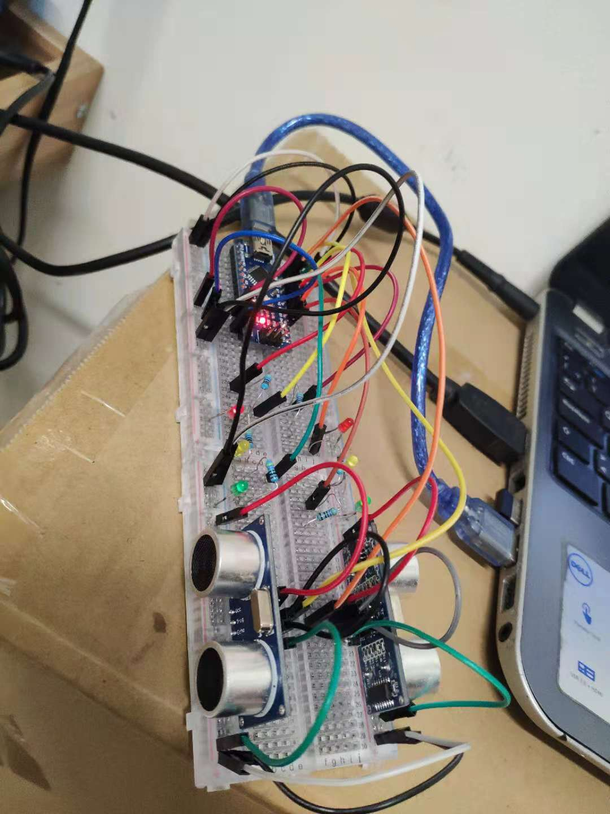
Project Hardware

Slide 8
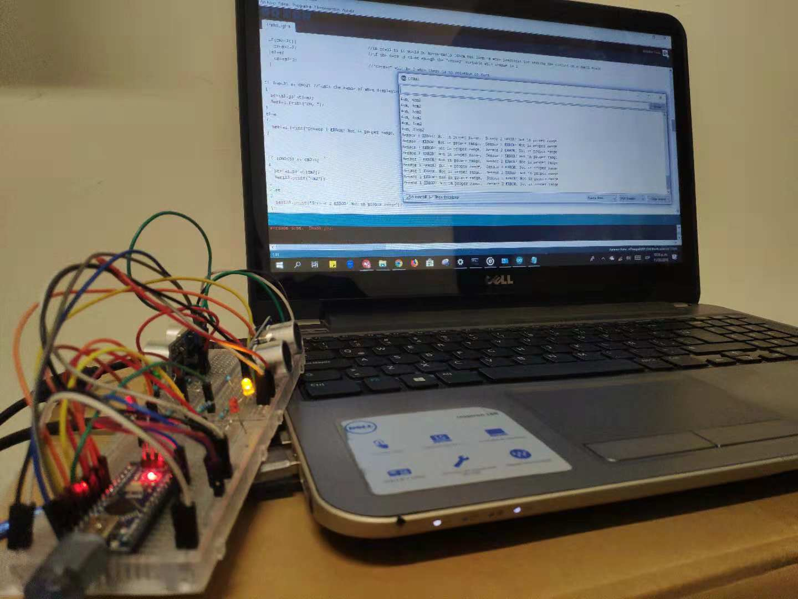
Hardware Assembly

Slide 9
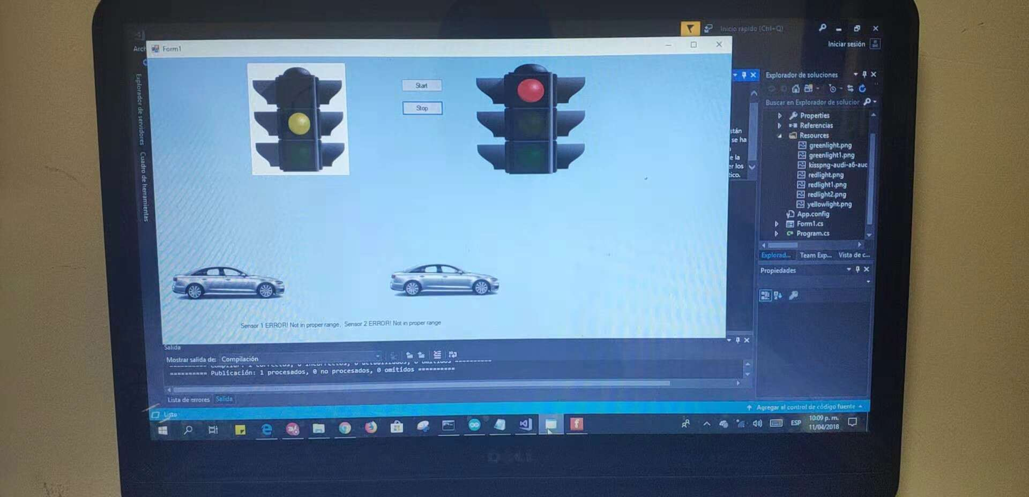
Project Screenshots

Slide 10
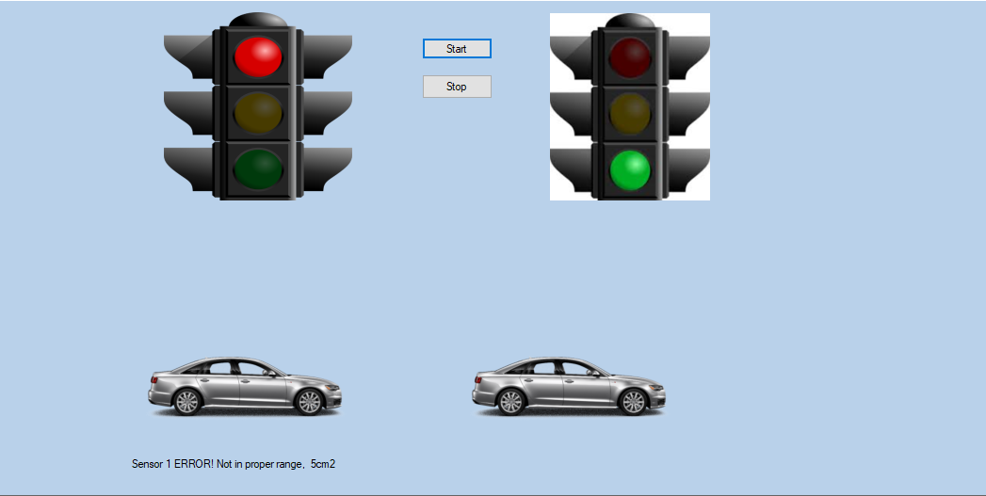
Project Screenshots

